Slide 1

Module 3
Master of Computer Applications III Sem
Subject code – Web Programming
Introduction to PHP

Slide 2

What is PHP?
Module No. 3
PHP stands for PHP: Hypertext Preprocessor
PHP is a widely-used, open source scripting language
PHP scripts are executed on the server
PHP is free to download and use

Slide 3
What is a PHP File?
Module No. 3
PHP files can contain text, HTML, JavaScript code, and PHP code
PHP code are executed on the server, and the result is returned to the browser as plain HTML
PHP files have a default file extension of ".php"

Slide 4
What Can PHP Do?
Module No. 3
PHP can generate dynamic page content
PHP can create, open, read, write, and close files on the server
PHP can collect form data
PHP can send and receive cookies
PHP can add, delete, modify data in your database
PHP can restrict users to access some pages on your website
PHP can encrypt data

Slide 5
Why PHP?
Module No. 3
PHP runs on different platforms (Windows, Linux, Unix, Mac OS X, etc.)
PHP is compatible with almost all servers used today (Apache, IIS, etc.)
PHP has support for a wide range of databases
PHP is free. Download it from the official PHP resource: www.php.net
PHP is easy to learn and runs efficiently on the server side

Slide 6
Set Up PHP on Your Own PC
Module No. 3
However, if your server does not support PHP, you must:
install a web server
install PHP
install a database, such as MySQL
The official PHP website (PHP.net) has installation instructions for
PHP: http://php.net/manual/en/install.php

Slide 7
Basic PHP Syntax
Module No. 3
A PHP script can be placed anywhere in the document. A PHP script starts with <?php and ends with ?>:
<?php
// PHP code goes here
?>
The default file extension for PHP files is ".php".

Slide 8
Module No. 3
Comments in PHP
 Example
<html>
<body>
<?php
//This is a PHP comment line
/*
This is a PHP comment block
*/
?>
</body>
</html>

Slide 9
PHP Variables
Module No. 3
Variable can have short names (like x and y) or more descriptive names (age, carname, totalvolume).
Rules for PHP variables:
A variable starts with the $ sign, followed by the name of the variable
A variable name must begin with a letter or the
underscore character
A variable name can only contain alpha-numeric characters and underscores (A-z, 0-9, and _ )
A variable name should not contain spaces
Variable names are case sensitive ($y and $Y are two different variables)

Slide 10
Creating (Declaring) PHP Variables
Module No. 3
PHP has no command for declaring a variable.
A variable is created the moment you first assign a value to it:
$txt="Hello world!";
$x=5;
After the execution of the statements above, the variable txt will hold the value Hello world!, and the variable xwill hold the value 5.
Note: When you assign a text value to a variable, put quotes around the value.

Slide 11
PHP is a Loosely Typed Language
Module No. 3
In the example above, notice that we did not have to tell PHP which data type the variable is.
PHP automatically converts the variable to the correct data type, depending on its value.
In a strongly typed programming language, we will have to declare (define) the type and name of the variable before using it.

Slide 12
PHP Variable Scopes
Module No. 3
The scope of a variable is the part of the script where the variable can be referenced/used.
PHP has four different variable scopes:
local
global
static
parameter

Slide 13
Local Scope
Module No. 3
A variable declared within a PHP function is local and can only be accessed within that function:
Example
<?php
$x=5; // global scope
function myTest()
{
echo $x; // local scope
}
myTest();
?>

Slide 14
Global Scope
Module No. 3
A variable that is defined outside of any function, has a global scope.
Global variables can be accessed from any part of the script, EXCEPT from within a function.
To access a global variable from within a function, use the global keyword:

Slide 15
Global Scope
Module No. 3
Example
<?php
$x=5; // global scope
$y=10; // global scope
function myTest()
{
global $x,$y;
$y=$x+$y;
}
myTest();
echo $y;
// outputs 15
?>

Slide 16
Static Scope
Module No. 3
When a function is completed, all of its variables are normally deleted. However, sometimes you want a local variable to not be deleted.
To do this, use the static keyword when you first declare the variable:

Slide 17
Static Scope
Module No. 3
 Example
<?php
function myTest()
{
static $x=0; echo $x;
$x++;
}
myTest();
myTest();
myTest();
?>
 OUTPUT ?

Slide 18
Parameter Scope
Module No. 3
A parameter is a local variable whose value is passed to the function by the calling code.
Parameters are declared in a parameter list as part of the function declaration:
 Example :
<?php
function myTest($x)
{
echo $x;
}
myTest(5);
?>

Slide 19
PHP echo and print Statements
Module No. 3
In PHP there is two basic ways to get output: echo and print.
There are some differences between echo and print:
echo - can output one or more strings
print - can only output one string, and returns always 1
Tip: echo is marginally faster compared to print as echo does not return any value.
<?php
echo "<h2>PHP is fun!</h2>";
echo "Hello world!<br>";
echo "This", " string", " was", " made", " with multiple parameters.";
?>

Slide 20
PHP Arrays
Module No. 3
 An array stores multiple values in one single variable:
Example
<?php
$cars = array("Volvo","BMW","Toyota");
echo "I like " . $cars[0] . ", " . $cars[1] . " and " .
$cars[2] . ".";
?>

Slide 21
Create an Array in PHP
Module No. 3
In PHP, the array() function is used to create an array:
Example :
$cars = array("Volvo","BMW","Toyota");
In PHP, there are three types of arrays:
Indexed arrays - Arrays with numeric index
Associative arrays - Arrays with named keys
Multidimensional arrays - Arrays containing one or more
arrays

Slide 22
PHP Indexed Arrays
Module No. 3
There are two ways to create indexed arrays:
The index can be assigned automatically (index always starts at 0):
$cars=array("Volvo","BMW","Toyota");
OR
The index can be assigned manually:
$cars[0]="Volvo";
$cars[1]="BMW";
$cars[2]="Toyota";

Slide 23
PHP Associative Arrays
Module No. 3
Associative arrays are arrays that use named keys that you assign to them.
There are two ways to create an associative array:
 $age=array("Peter"=>"35","Ben"=>"37","Joe"=>"43 ");
OR
 $age['Peter']="35";
$age['Ben']="37";
$age['Joe']="43";

Slide 24
PHP Associative Arrays
Module No. 3
 Example
<?php
$age=array("Peter"=>"35","Ben"=>"37","Joe"=>"43"); echo "Peter is " . $age['Peter'] . " years old.";
?>
// Output : Peter is 35 years old.

Slide 25
PHP Multidimensional Arrays
Module No. 3
An array can also contain another array as a value, which in turn can hold other arrays as well. In such a way we can create two- or three-dimensional arrays:
Example
<?php
// A two-dimensional array:
$cars = array (
array("Volvo",100,96),
array("BMW",60,59),
array("Toyota",110,100)
);
?>

Slide 26
The foreach Loop
Module No. 3
The foreach loop works only on arrays, and is used to loop through each key/value pair in an array. foreach ($array as $value)
{
code to be executed;
}
For every loop iteration, the value of the current array element is assigned to
$value (and the array pointer is moved by
one) - so on the next loop iteration, you'll be looking at the next array value.

Slide 27
The foreach Loop
Module No. 3
Example:
<?php
$x=array("one","two","three"); foreach ($x as $value)
{
echo $value . "<br>";
}
?>

Slide 28
PHP Functions
Module No. 3
PHP User Defined Functions
Besides the built-in PHP functions, we can create our own
functions.
A function is a block of statements that can be used repeatedly in a program.
A function will not execute immediately when a page loads.
A function will be executed by a call to the function.
Create a User Defined Function in PHP
A user defined function declaration starts with the word "function":
Syntax
function functionName(arg1, arg2…)
{
code to be executed;
}
 Note: A function name can start with a letter or underscore (not a
number).

Slide 29
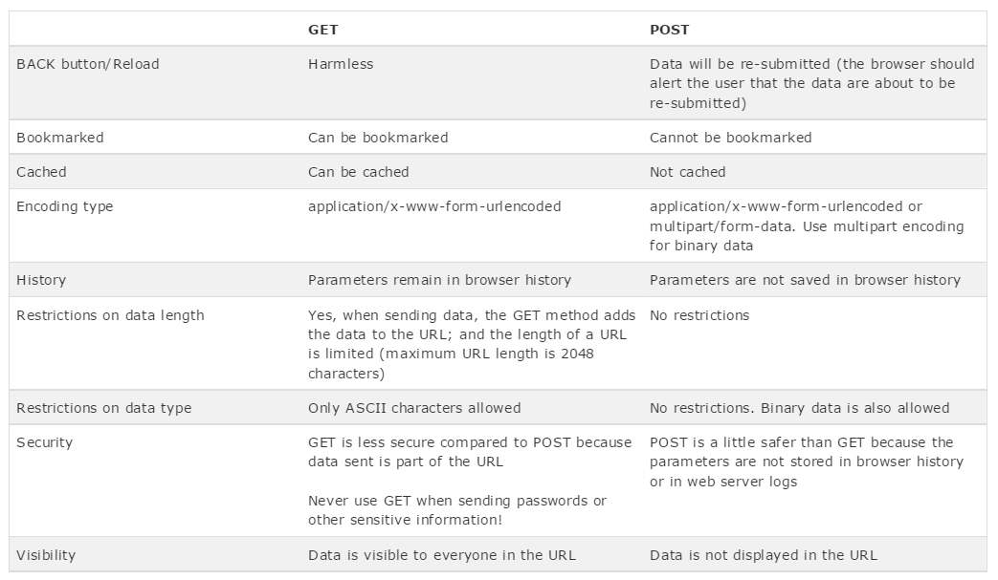
GET Vs POST
Module No. 3

Slide 30
PHP $_GET Variable
Module No. 3
The predefined $_GET variable is used to collect values in a form with method="get"
Information sent from a form with the GET method is visible to everyone (it will be displayed in the browser's address bar) and has limits on the amount of information to send.
Example
<form action="welcome.php" method="get"> Name: <input type="text" name="fname"> Age: <input type="text" name="age">
<input type="submit">
</form>

Slide 31
Module No. 3
When the user clicks the "Submit" button, the URL sent to the server could look something like this:
http://www.w3schools.com/welcome.php?fname=Peter&age=37
The "welcome.php" file can now use the $_GET variable to collect form data as follow:
Welcome <?php echo $_GET["fname"]; ?>.<br> You are <?php echo $_GET["age"]; ?> years old!

Slide 32
The $_POST Variable
Module No. 3
The predefined $_POST variable is used to collect values from a form sent with method="post".
Information sent from a form with the POST method is invisible to others and has no limits on the amount of information to send.
Note: However, there is an 8 MB max size for the POST method, by default (can be changed by setting the post_max_size in the php.ini file).

